Slide 1

Organizational Behavior
(MGT-502)
Lecture-24

Slide 2
Summary of
Lecture-23

Slide 3
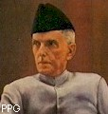

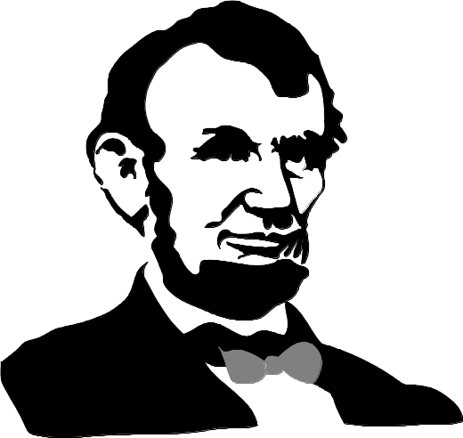
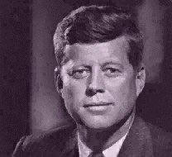
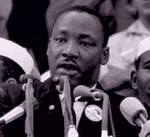
Leadership

Slide 4
Group
Phenomenon
Influence
and Persuasion
The Basics
of Leadership
Some Form
of Hierarchy
Goal Directed
Behavior
Notes:
3

Slide 5
Distinctions Between Managers and Leaders
Leaders
  Innovate
  Develop
  Inspire
  Take the long-term view
  Ask what and why
  Originate
  Challenge the status quo.
Managers
  Administer
  Maintain
  Control
  Have a short-term view
  Ask how and when
  Accept the status quo

Slide 6
What Makes a Good Leader?
Theories fall into 3 categories:
A. Trait theories
  look for the major characteristic common to all effective leaders
B. Behavioral theories
  examine the actual behavior of effective leaders to determine what kinds of behaviors lead to success
C. Contingency theories
  leader effectiveness depends (or is contingent) upon the interaction of leader behavior and the situation

Slide 7

Trait Theory
People are born with certain characteristics which make
them leaders.

Slide 8
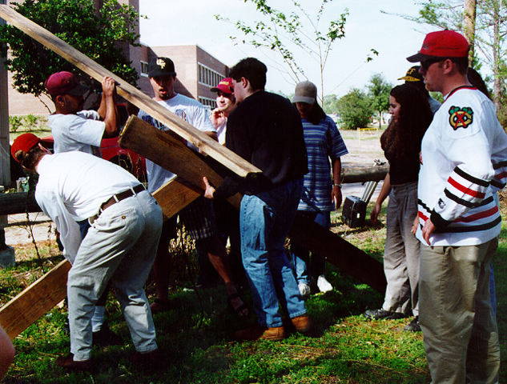
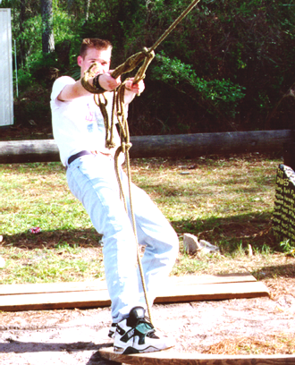
Behavioral theories
There are behavioral determinants of leadership which can be learned.
People can be trained to be effective leaders.

Slide 9
Contingency Theories

Slide 10
Path-Goal Model
Follower/Subordinate Characteristics
Locus of control
Experience
Ability
Leader Behavior/Styles
Directive
Supportive
Participative
Achievement-oriented
Followers/Subordinates
Perceptions
Motivation
Outcomes
Satisfaction
Performance
Environmental Factors
Tasks
Formal authority system
Work group

Slide 11
Transformational & Transactional Leaders
Transformational leaders
  Leading -- changing the organization to fit the environment
  Develop, communicate, enact a vision
Transactional leaders
  Managing -- linking job performance to rewards
  Ensure employees have necessary resources
  Apply contingency leadership theories

Slide 12
Trust and Leadership
Leadership
TRUST
and
INTEGRITY

Slide 13


Slide 14
Today’s Topics

Slide 15
Power
What is it?
Do you have any?
Do you want some?
How can you get some?

Slide 16
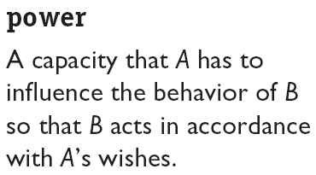
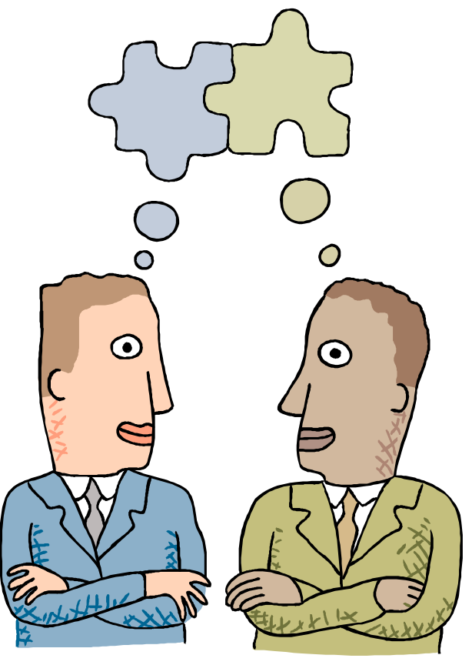
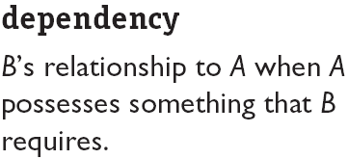
A Definition of Power
B
A

Slide 17
Concept of Power
Power - the ability to influence another person
Influence - the process of affecting the thoughts, behavior, & feelings of another person
Authority - the right to influence another person
Notes:
2

Slide 18
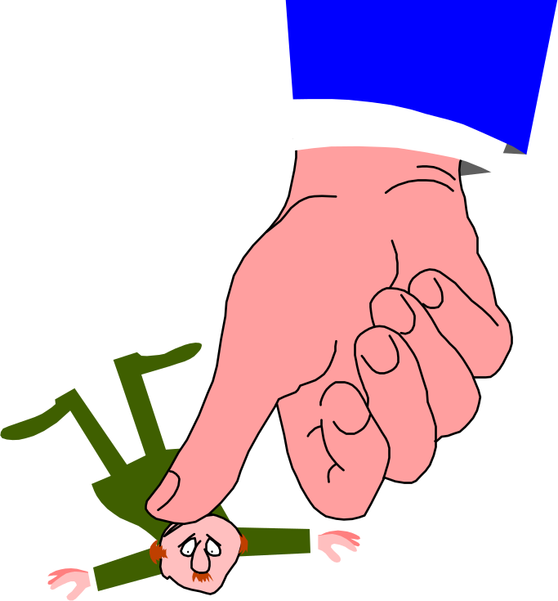
COERCIVE
Exists when one person believes another person can and will provide or withhold punishment

Slide 19
REWARD
Exists when one person believes another person can and will provide or withhold rewards

Slide 20
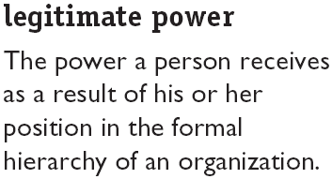
LEGITIMATE
Exists when one person believes that another person has the right to influence him or her (authority)

Slide 21

REFERENT (CHARISMATIC)
Exists when one person finds another personally attractive and wants to be associated with or affiliated with that person

Slide 22
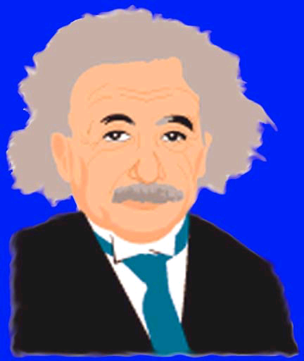
EXPERT
Exists when one person believes another person has desired expertise and is willing to share or withhold it

Slide 23
RESOURCE
Exists when one person believes that another person has desired (nonexpert) resources and is willing to share or withhold them

Slide 24
PRINCIPLES OF POWER
Power is perceived
Power is relative
Power bases must be coordinated
Power is a double-edged sword (used and abused)

Slide 25
Unit of Analysis
Influence
Power
Control

Slide 26
INTERPERSONAL POWER
The ability to influence others and maintain control over your own fate

Slide 27

Sources of Organizational Power: Interpersonal
Reward Power - agent’s ability to control the rewards that the target wants
Coercive Power - agent’s ability to cause an unpleasant experience for a target
Legitimate Power - agent and target agree that agent has influential rights, based on position and mutual agreement
Referent Power-based on interpersonal attraction
Expert Power - agent has knowledge target needs
Notes:
4

Slide 28
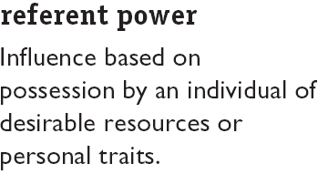

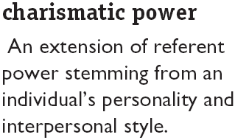
Personal Power

Slide 29
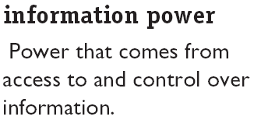

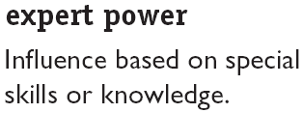
Personal Power

Slide 30
Positional Power
Power flows down the organization through delegation

Slide 31
Which Power is Most Effective?
Expert Power!
Strong relationship to performance & satisfaction
Transfers vital skills, abilities, and knowledge within the organization
Employees internalize what they observe & learn from managers they consider “experts”
Notes:
5

Slide 32
Consequences of Power
Sources of Power
Consequences of Power
Expert
Power
Commitment
Referent
Power
Legitimate Power
Compliance
Reward
Power
Resistance
Coercive
Power

Slide 33


What is the Relationship between Power and Leadership?

Slide 34


Leaders and power
Power is the capacity of a leader to influence work actions or decisions.
Five sources of power:
      Legitimate power
      Coercive power
      Reward power
      Expert power
      Referent power

Slide 35
Contrasting Leadership and Power
Leadership
  Focuses on goal achievement.
  Requires goal compatibility with followers.
  Focuses influence downward.
Research Focus
  Leadership styles and relationships with followers.
Power
  Used as a means for achieving goals.
  Requires follower dependency.
  Used to gain lateral and upward influence.
Research Focus
  Power tactics for gaining compliance.

Slide 36
Power and Dependence
Person B’s counterpower over Person A
Person
A
Person
B
Person
B’s Goals
Person A’s power over Person B

Slide 37
Dependency: The Key To Power
The General Dependency Postulate
  The greater B’s dependency on A, the greater the power A has over B.
  Possession/control of scarce organizational resources that others need makes a manager powerful.
  Access to optional resources (e.g., multiple suppliers) reduces the resource holder’s power.
What Creates Dependency
  Importance of the resource to the organization
  Scarcity of the resource
  Nonsubstitutability of the resource

Slide 38
ORGANIZATIONAL POWER MANAGEMENT
Empower to punish others
Select charismatic individual
Select & train for desired expertise
Empower to reward others
Assign to position of authority
Provide resources to manage

Slide 39
PERSONAL POWER MANAGEMENT
Use & make authority known
Be a nice person
Acquire and make expertise known
Show ability to provide or with-hold rewards
Acquire and make resources known
Show ability to provide or with-hold punishment

Slide 40
Using Power Ethically
Does the behavior produce a good outcome for people both inside and outside the organization?
Does the behavior respect the rights of all parties?
Does the behavior treat all parties equitably and fairly?
Notes:
6

Slide 41


Two Faces of Power
Personal Power
  used for personal gain
Social Power
  used to create motivation
  used to accomplish group goals
Notes:
7

Slide 42
Political Behavior in Organizations
Organizational Politics - the use of power and influence in organizations
Political Behavior - actions not officially sanctioned by an organization that are taken to influence others in order to meet one’s personal goals
Notes:
14

Slide 43
Politics in Organizations
Legitimate
Political
Behavior
Illegitimate
Limited Resources
The Reality
of Politics
Ambiguous Decisions

Slide 44
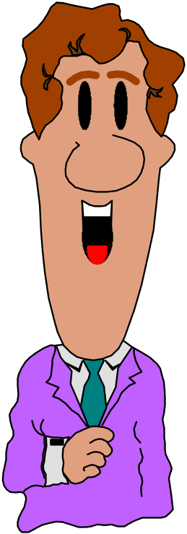
ORGANIZATIONAL POLITICS
I’ll support your bill if you support mine
The use of power in non-prescribed ways (means) and/or for non-prescribed purposes (ends)

Slide 45
Organizational Factors that
Contribute to Political Behavior
Low trust
Democratic decision making
High performance pressures
Scarcity of resources
Role ambiguity
Self-serving senior managers
Unclear evaluation systems
Zero-sum allocations

Slide 46
Types of Organizational Politics
Managing
impressions
Attacking and
blaming
Types of
Organizational
Politics
Creating
obligations
Controlling
information
Cultivating
networks
Forming
coalitions

Slide 47
Conditions for Organizational Politics
Personal
Characteristics
Scarce
Resources
Conditions
Supporting
Organizational
Politics
Tolerance of
Politics
Complex and
Ambiguous
Decisions

Slide 48
Information and Power
Control over information flow
  Based on legitimate power
  Relates to formal communication network
  Common in centralized structures (wheel pattern)
Coping with uncertainty
  Those who know how to cope with organizational uncertainties gain power
    Prevention
    Forecasting
    Absorption

Slide 49
Managing Political Behavior
Maintain open communication
Clarify performance expectations
Use participative management
Encourage cooperation among work groups
Manage scarce resources well
Provide a supportive organizational climate
Notes:
17

Slide 50
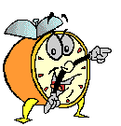
Let’s stop it here

Slide 51
Summary

Slide 52
Next….

Slide 53
Organizational Behavior
(MGT-502)
Lecture-24

